Slide 1
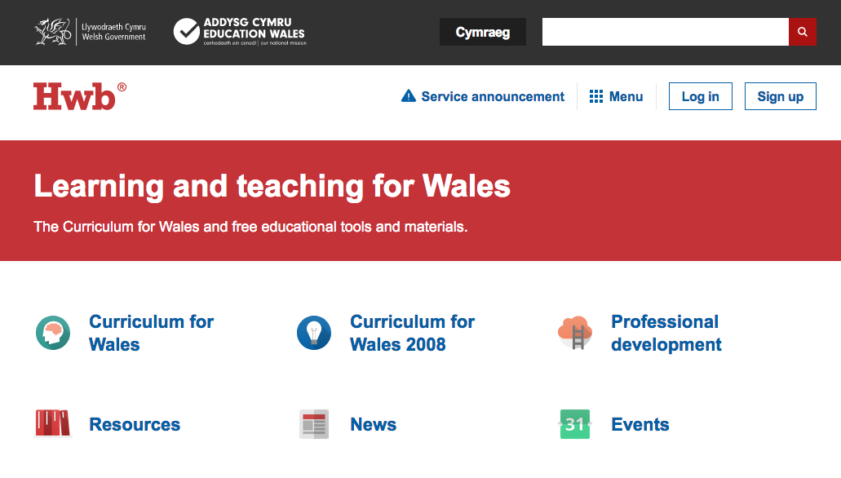
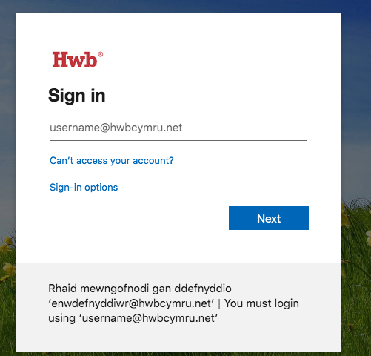
Guide for accessing your child’s Google Classroom - 1
Open a web browser, for example Chrome, Firefox, Safari(Mac), Explorer(Windows).
Search ‘Hwb’ and click the top hit, or go to https://hwb.gov.wales/.
Click Log-in and enter your child’s username and password. If you don’t know these please email your child’s class teacher or headteacher.

Slide 2
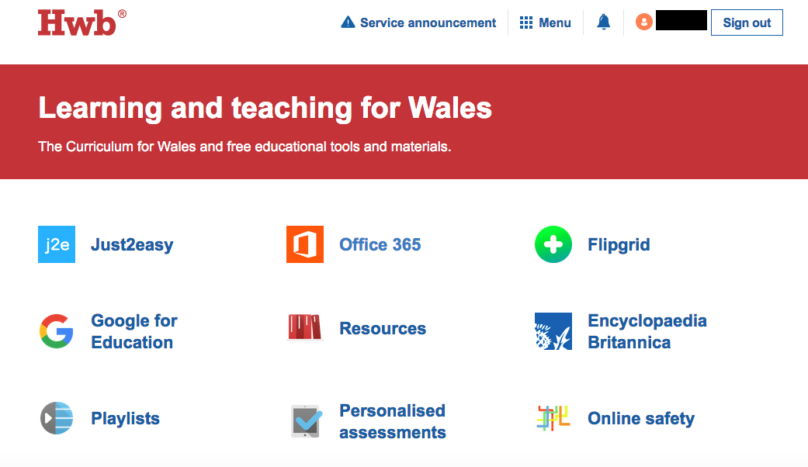
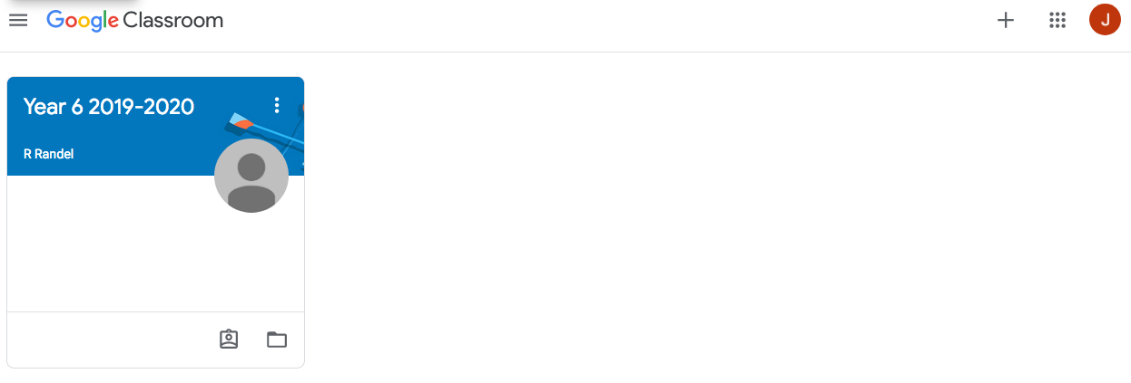
Guide for accessing your child’s Google Classroom - 2
4. When signed into Hwb - click on Google for Education.
5. Google may then ask again for the child’s username and password. Use the same Hwb username and password that you used to sign-in.
6. Click here just to check that you are in your child’s ‘...@hwbcymru.net’ account and not your own personal Gmail account.
If it is your personal one, please click ‘add account’ and enter your child’s Hwb sign-in details.

Slide 3
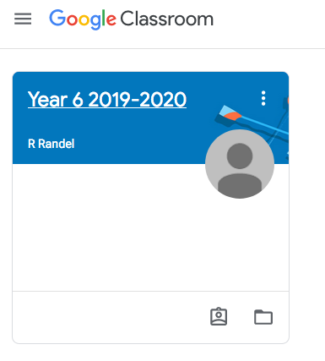
Guide for accessing your child’s Google Classroom - 3
7. Click here, on the top right and enter your child’s class code. Your child should have received this in school, but if not, please email the class teacher or headteacher to get it.
8. You will now see your child’s class when you or they log into Google Classroom.

Slide 4
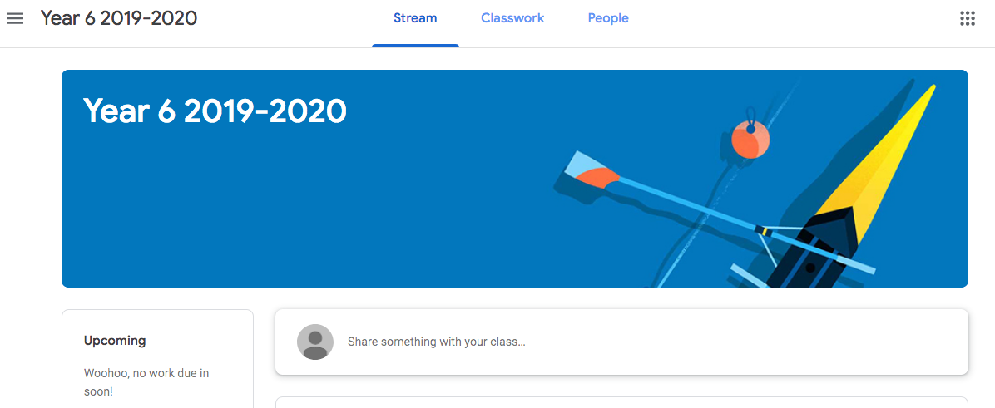
Guide for accessing your child’s Google Classroom - 4
9. Click here for the Google Classroom stream. Here you will see general messages from the class teacher and other pupils along with updates of assignments set.
10. Click here to see the classwork that your child’s teacher has assigned.

Slide 5
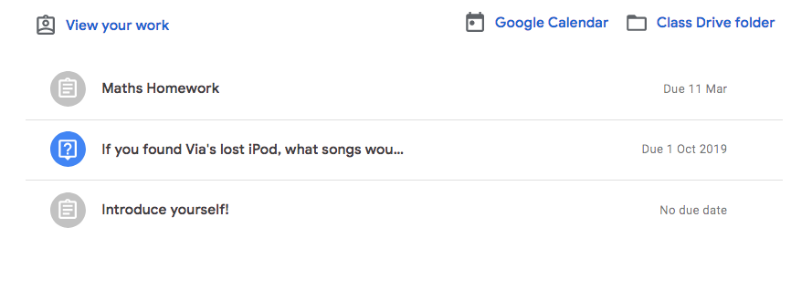
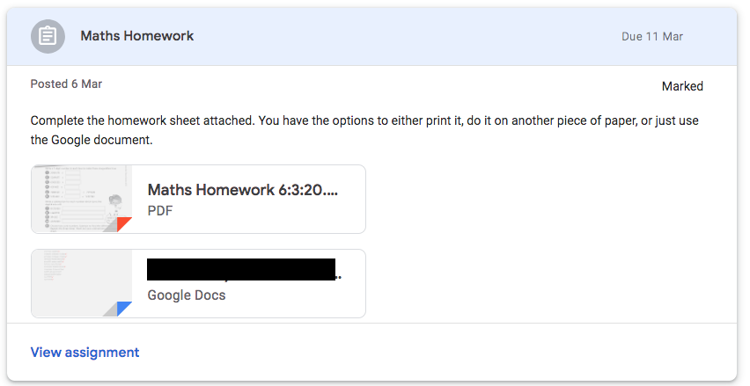
Guide for accessing your child’s Google Classroom - 5
11. Click the assignment to see the resources and instructions to complete the set work.
12. Here you will see the task and the online resources/materials required to complete it.
Once completed the work can then be sent back to the teacher.

